Slide 1
Truth Tables
The animated version (teaching method 2)
Chalk v.s. The Computer

Slide 2
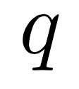
Free propositions (the smallest of the small)
Last time we saw we need to run through every combination of true and false of our “free” propositions that is

Slide 3
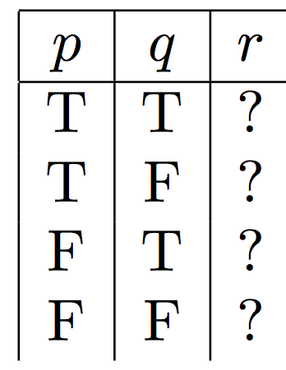
No problem!
2 choices!
repeat this twice

Slide 4
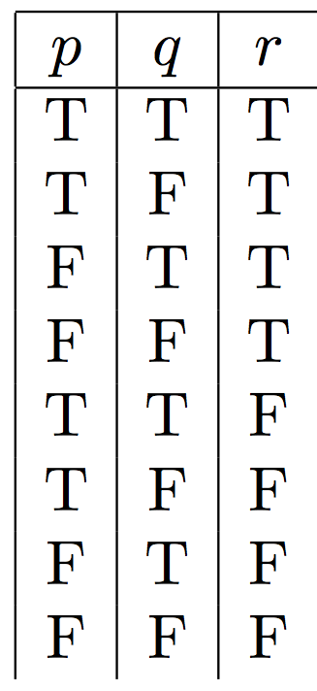

Slide 5
Break down the expression
To see when this expression is true it is most convenient to break down the proposition into smaller pieces
This is a NEW proposition

Slide 6
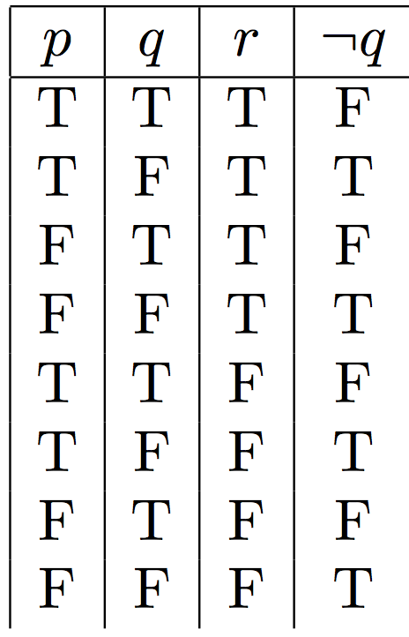

Slide 7
Break down the expression
We continue to break it down!
This is a NEW proposition

Slide 8
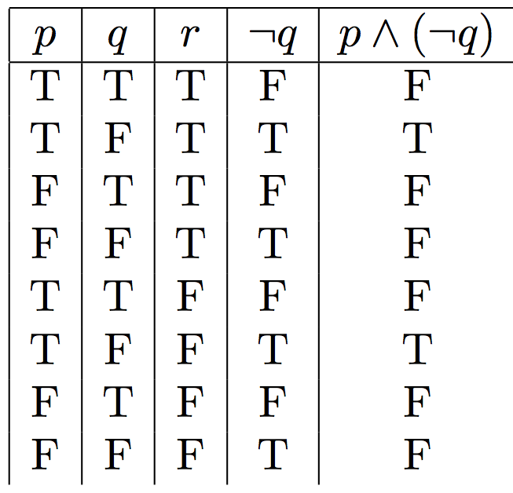

Slide 9
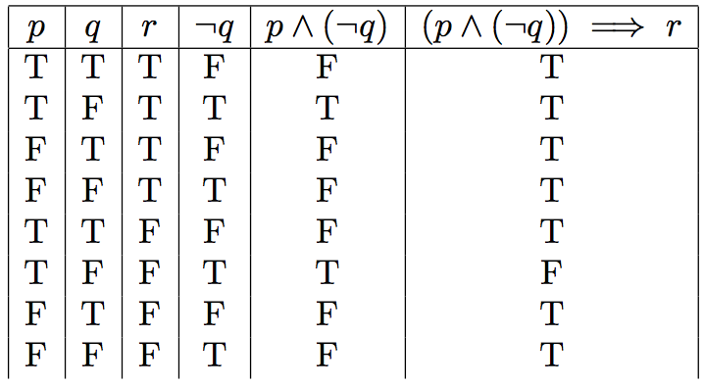

Slide 10
Free propositions (the smallest of the small)
So how do we start this one?

Slide 11
2 choices!
repeat this twice

Slide 13
Break down the expression
To see when this expression is true it is most convenient to break down the proposition into smaller pieces
This is a NEW proposition

Slide 14
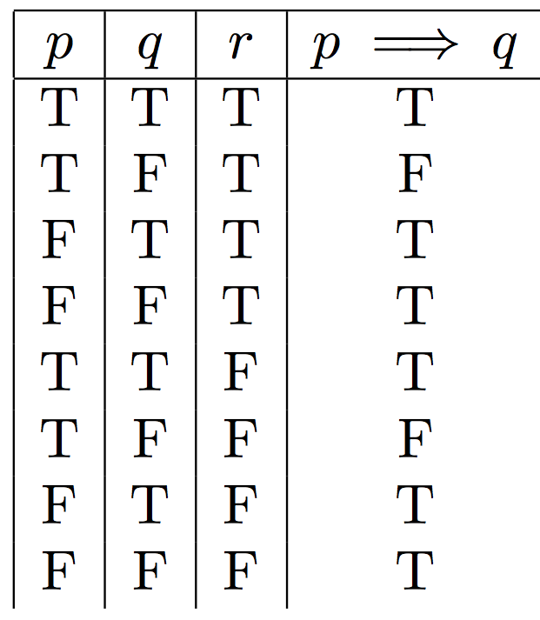

Slide 15
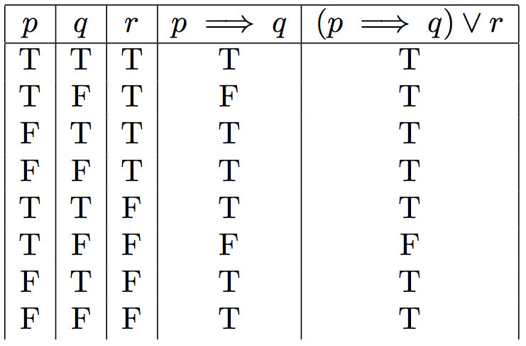

Slide 16
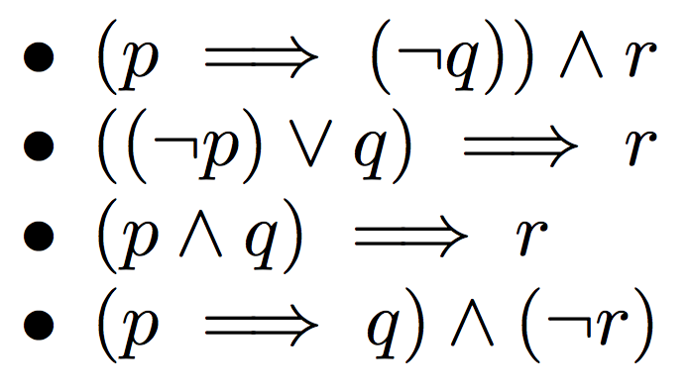
Group Work (teaching method 3)
Construct a truth table for the following:
(RC)
(GR)
(HP)
(SL)

